Slide 1
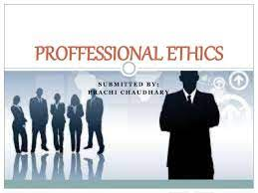
Chapter 7 Professional Ethics
Professional Ethics

Slide 2
Characteristics of a Profession
Initial professional education التعليم المهني
Accreditationالاعتماد الاكاديمي
Skills development تطوير المهارات
Certification شهادة
Licensing ترخيص
Professional developmentالتطوير المهني
Code of ethics مدونة الاخلاق
Professional societyالمجتمع المهني

Slide 3
Chapter Overview
Introduction
Is software engineering a profession?
Software engineering code of ethics
Analysis of the code
Case studies
Whistleblowing كاشف الفساد

Slide 4
Introduction
Profession (informal)
High level of education
Practical experience
Decisions have impact
We pay professionals well
Doctors
Lawyers
We expect professionals to act for public good

Slide 5
Certified Public Accountantsمحاسبين قانونيين
Bachelor’s degree
150+ semester hours
24+ hours of accounting-related classes
Two years’ experience working under supervision of a CPA
CPA exam
To retain certification
Continuing education
Follow code of ethics

Slide 6
Software Engineers
Responsibilities of a software engineer:
analyze user requirements
write and test code, refining and rewriting it as necessary and communicate with any programmers involved in the project
research, design and write new software programs (e.g. business applications or computer games) and computer operating systems.
Work closely with other staff, such as project managers, graphic artists, UX designers, other developers, systems analysts and sales and marketing.

Slide 7
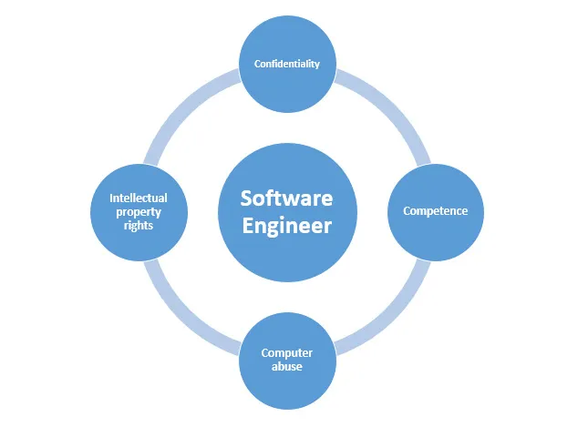

incompatible platforms to work together
create technical specifications
write operational documentation with technical authors
maintain systems by monitoring and correcting software defects

Slide 8
Software Engineering Code: Preamble
Eight principles identify key ethical relationships and obligations التزامات within this relationship.

Slide 9
Software Engineering Code Principles ) Eight principles identify key ethical (
Public خدمة عامة
Client and employer يراعي العميل والمسؤول
Product جودة المنتج
Judgment تحكيم
Management متطلبات الإدارة
Professionخبير
Colleagues يعمل مع فريق
Self تطوير ذاتي

Slide 10
Analysis of Preamble
No mechanical process for determining if an action is right or wrong.
Should not take an overly legalistic view of the Code
If Code doesn’t forbid something, that doesn’t mean it is morally acceptableإذا كانت التعليمات البرمجية لا تمنع شيئًا ما ، فهذا لا يعني أنه مقبول أخلاقياً
Code reflects principles drawn from multiple ethical theories ( post on Facebook)

Slide 11
Origin of Virtue Ethics
Aristotle ارسطو
Happiness results from living a life of virtue فضيلة
Intellectual virtue: developed through educationفضيلة فكرية
Moral virtue: developed by repeating appropriate acts فضيلة أخلاقية
Deriving pleasure from a virtuous act is a sign that the virtue has been acquiredإن اشتقاق المتعة من فعل فاضل هو علامة على اكتساب الفضيلة

Slide 12
Some virtues: Benevolence, courage, fairness, generosity, honesty, loyalty, patience, tolerance
. الإحسان ، الشجاعة ، الإنصاف ، الكرم ، الصدق ، الولاء ، الصبر ، التسامح.
A person of strong moral characterشخص ذو شخصية اخلاقية قوية
possesses many virtues
knows the right thing to do in each situation

Slide 13
Strengths of Virtue Ethics
Provides a motivation for good behavior
Provides a solution to the problem of impartiality الحياد
Some virtues are partial (generosity الكرم جزئي )
Other virtues must be impartial (honestyالأمانة )
Weakness of Virtue Ethics
No methodology for answering moral problems
Given a problem, which virtues apply?
بالنظر إلى المشكلة ، ما هي الفضائل التي تنطبق؟
How to resolve a conflict between more than one virtue?

Slide 14
Fundamental Principles of Professional Ethics اخلاقيات المهنة
Be impartial. حيادي
Disclose information that others ought to know.افصح عن المعلومات التي يجب أن يعرفها الآخرون.
Respect the rights of others. احترم حقوق الآخرين.
Treat others justly. عامل الآخرين بعدل
Take responsibility for your actions and inactions.
Take responsibility for the actions of those you supervise..
Continually improve your abilities.
Share your knowledge, expertise, and values.

Slide 15
Case: Software Recommendation
Sam Shaw asks for free advice on LAN security.
Prof. Smith answers questions and recommends top-ranked package.يوصي بحزم ذات تصنيف عالي
Prof. Smith does not disclose لم تخبر
She has financial interest in company producing top-ranked package.عندها شركة نت تنتج هذه الحزم
Another package was given a “best buy” rating.
مع توفر حزم افضل وارخص
Did Prof. Smith do anything wrong?

Slide 16
Analysis
Most relevant principles
Be impartial.
Disclose information others ought to know.
Share your knowledge, expertise, and values.
Prof. Smith was deceptive. كان الأستاذ سميث مخادعًا
Prof. Smith freely gave valuable information.
قدم البروفيسور سميث معلومات قيمة بحرية
Prof. Smith did not reveal conflict of interest.
لم يكشف البروفيسور سميث عن تضارب في المصالح.

Slide 17
Overview of Whistleblowing
Whistleblower
Tries to report harmful situation through authorized channels.البلاغ عن الفساد بشكل رسمي
Rebuffed by organization.رفض المنظمة
Makes disclosure through unauthorized channels.
يتجه لقنوات غير رسمية ( خاصة)
Whistleblowers punished for their actions
Lose job or all chances of advancement يحرمون من الوظيفة وفرص الترقي فيها.
Financial and emotional hardship مشاكل مالية و أخلاقية
False Claims Act قانون الادعاءات الكاذبة
Whistleblower Protection Actقانون حماية المبلغين عن المخالفات

Slide 18
CaseStudy: Morton Thiokol/NASA
Challenger explosion المتحدي \ انفجار تشالنجر 1986
Roger and Morton engineers documented the dangers of low-temperature launches بلاغات من مهندسين
Morton Thiokol executives and NASA officials overrode and hid concerns اخفوا مخاوفهم
Roger shared information with the Presidential Commission تبادل المعلومات مع اللجنة الرئاسية
Morton retaliated ردة فعله
Roger took medical leave because of stress, and then quit
He found job as a consultant two years later مستشارة

Slide 19
Motives of Whistleblowers دوافع المبلغين
People become whistleblowers for different reasons.
Morality of action may depend on motives.
Good motive.
Desire to help the publicالرغبة في مساعدة الجمهور
Questionable motives دوافع مشكوك فيها
Retaliationالانتقام
Avoiding punishmentتجنب العقوبة

Slide 20
Corporate Response to Whistleblowing
Whistleblowers are disloyal خائنون
If company causes harm, public can use legal remedies to seek damages
إذا تسببت الشركة في ضرر ، فيمكن للجمهور استخدام سبل الانتصاف القانونية لطلب التعويضات

Slide 21
Whistleblowing as Organizational Failure
Whistleblowing harms organization
Ruined careersمهن محطمة
Bad publicity دعاية إعلامية سيئة
Disruption of organization’s social fabricتعطيل النسيج الاجتماعي للمنظمة
Makes it hard for people to work as team قتل روح الفريق
Whistleblowing harms whistleblowerإبلاغ عن المخالفات يضر المبلغين
Retaliation الانتقام
Estrangement منبوذ\التغريب

Slide 22
Organizations should improve communication
Robert Spitzer: Organizations should return to using
principle-based ethics in decision making
روبرت سبيتزر: يجب أن تعود المنظمات إلى استخدام الأخلاق المبنية على المبادئ في صنع القرار
#Example:
The most common example is price fixing. تثبيت الأسعار
over-billing or billing for services not performed تزوير الفواتير
concealing safety concerns السلامة العامة
false certifications by educational institutions .تزوير شهادات علمية

Slide 23
Whistleblowing as Moral Dutyالإبلاغ عن المخالفات كواجب أخلاقي
Richard DeGeorge’s questions for whistleblowing
Is serious harm to the public at stake? هل الضرر الجسيم للجمهور على المحك؟
Have you told your manager?
Have you tried every possible inside channel?
Do you have persuasive documented evidence?ادلة مقنعة موثقة
Are you sure whistleblowing will work ? هل سيكون مفيد
Under what conditions must you blow the whistle?
DeGeorge's : If all five conditions are met
Others: If conditions 1-3 are met
Still others: Whistleblowing is never morally required تصرف غير أخلاقي

Slide 24


